Slide 1
My Journey Through Tech: From Word Processors to Mt. Stupid

Slide 2
Welcome to the community
“If you’re serious about changing your life, you’ll find a way. If not, you’ll find an excuse.”

Slide 3
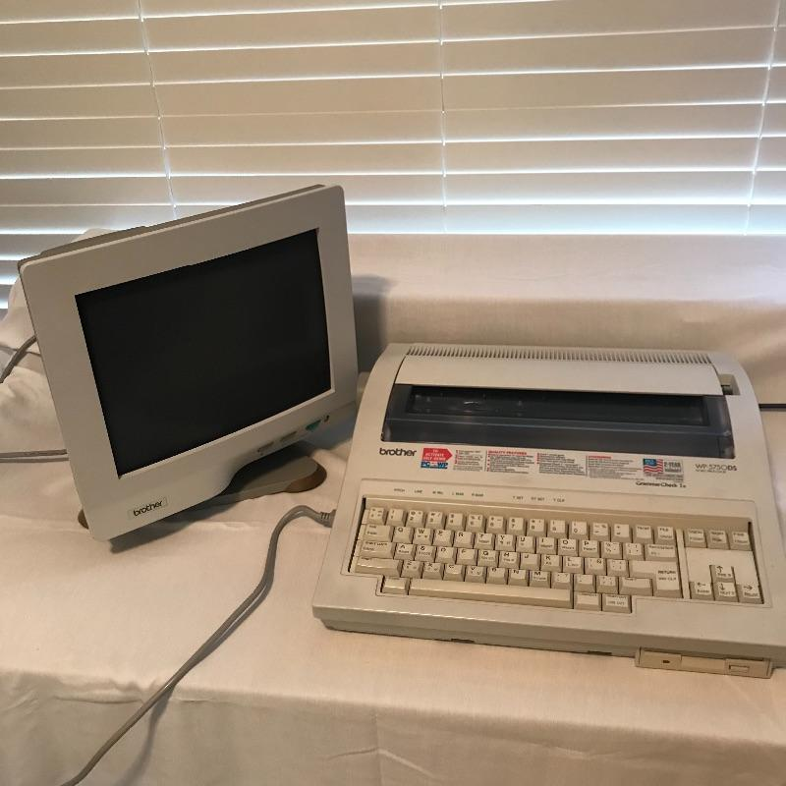
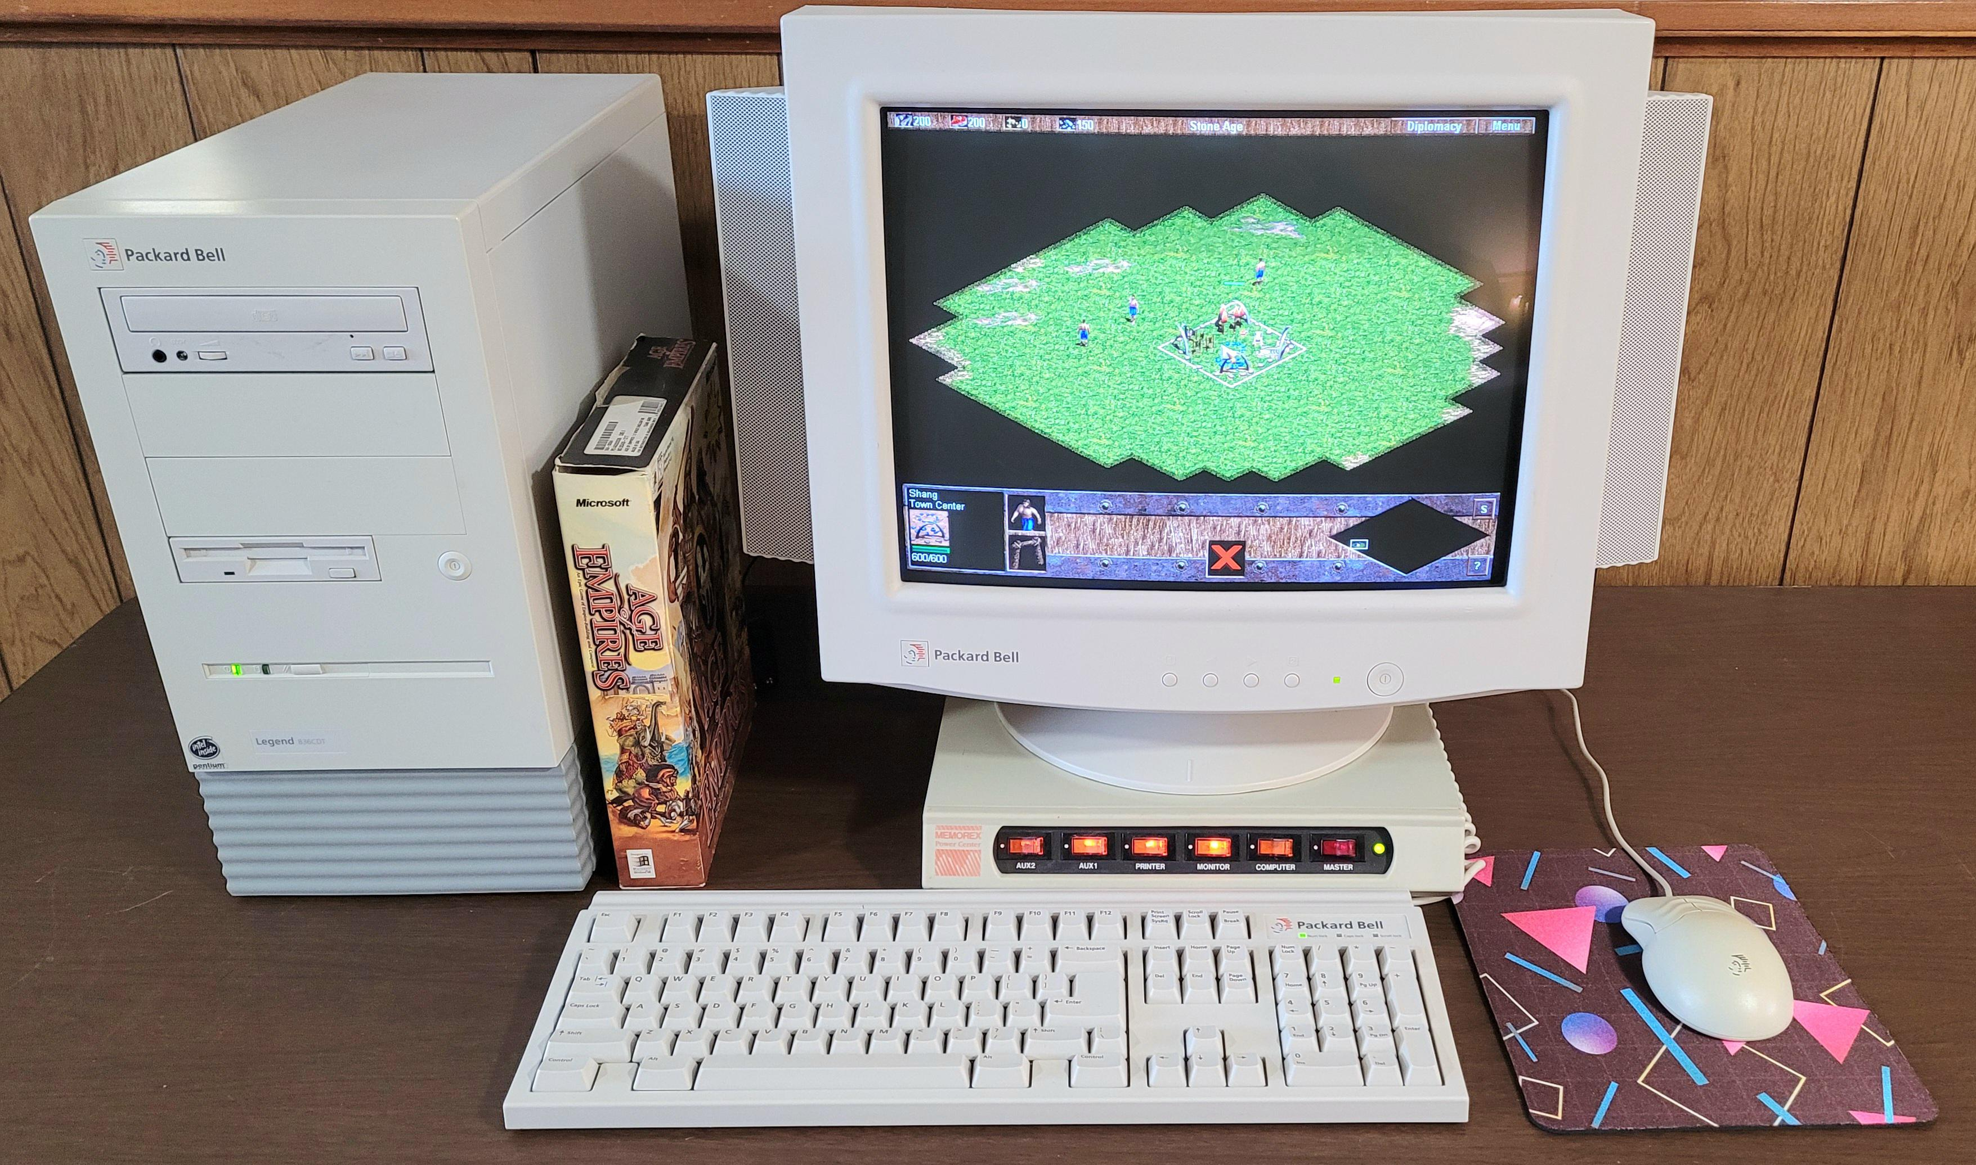
Humble Beginnings
Raised by my very supportive grandmother (born 1932)
First exposure to tech: a Brothers Word Processor and Packard Bell Desktop

Slide 4

Applying blind
Applied to multiple journalism programs: teacher’s advice
Applied to USM for Computer Science (SPOILER ALERT: I had no idea what this major involved!)
Struggled hard with Intro to C++ but stuck with it

Slide 5
2004: The Year of Change
June – First job
September - Became a dad ❤️
October – My 22nd Birthday
December – Graduated college 🎓

Slide 6
First Job, First Reality check
My first job paid less than Domino’s Pizza
Worked a second full-time job delivering pizzas to survive
But I stuck with coding because I knew it would pay off and I finally knew exactly what I wanted to do with my life.

Slide 7
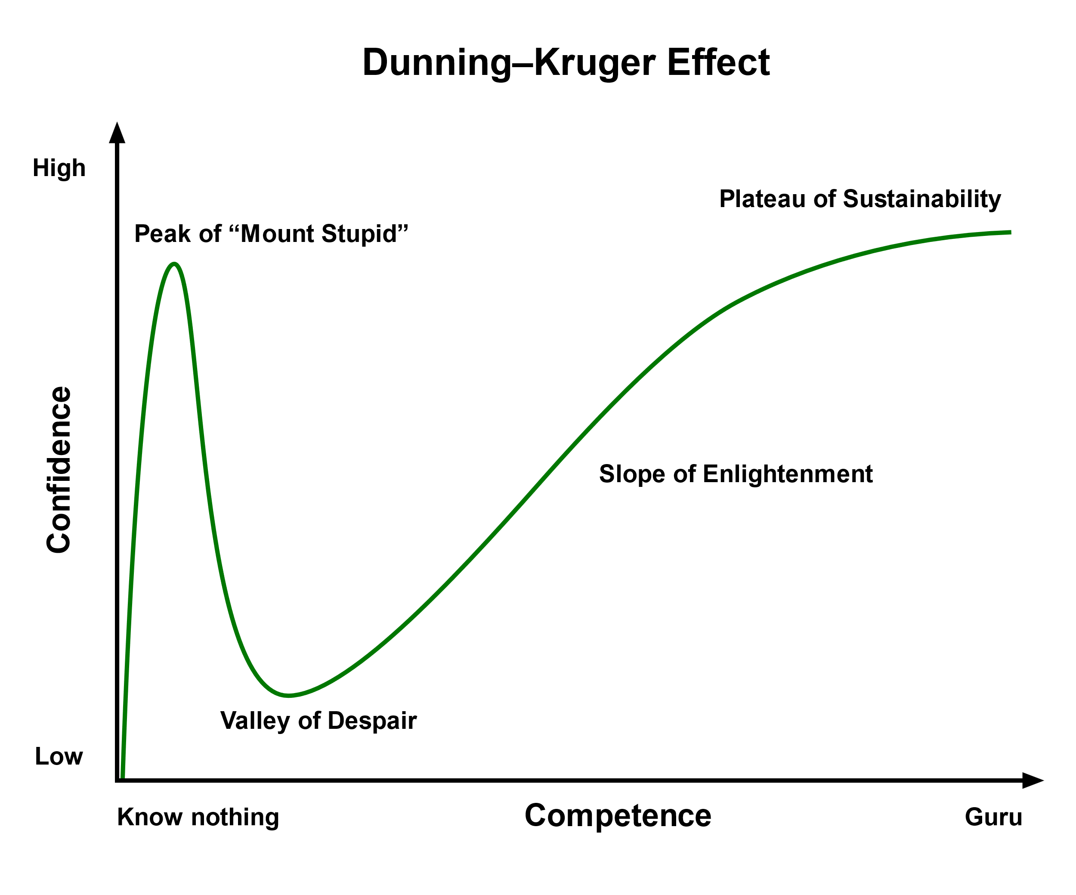
The Dunning-Kruger effect describes a cognitive bias where individuals with low ability in a specific area tend to overestimate their competence, while those with high ability tend to underestimate their skills.

Slide 8
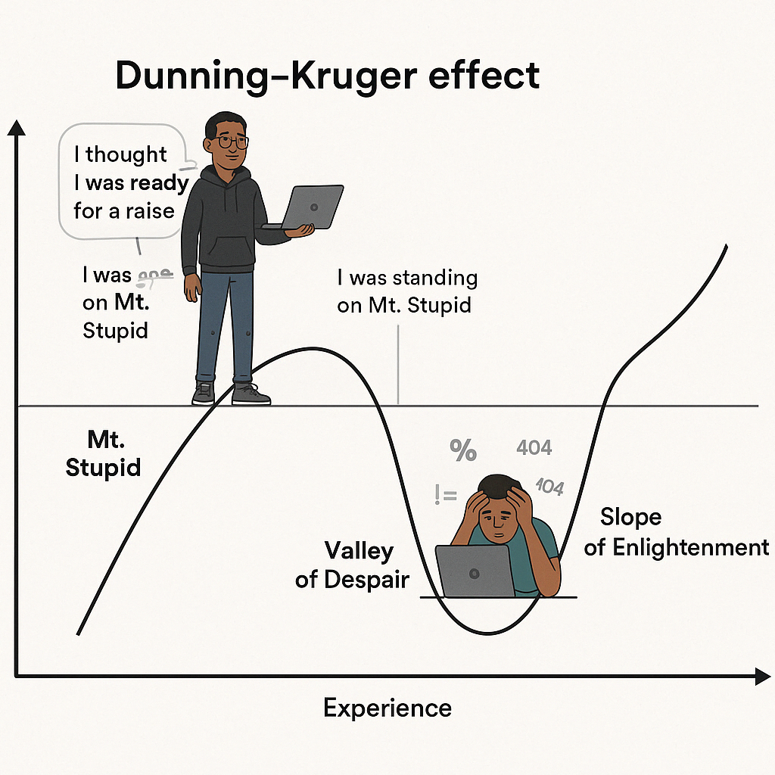
My Mt. Stupid Moment
I asked for my first raise and received the most important “NO” of my life. My supervisor said, “You’re not that good. You’re doing the bare minimum. If you think you deserve more why are you still here?”

Slide 9
Climbing out of the valley
Took ownership of my skills
Asked my peers for help
Studied their code
Found mentors

Slide 10
Lessons I’ve Learned
Don’t stop interviewing (know your worth, industry trends, and keep your interview skills fresh)
Don’t stop learning (GitHub everything)
Volunteer
Network (https://www.noladevs.org/)
Communication: verbal & written
Be kind. Set Boundaries. Stay Humble.

Slide 11
THANK YOU
Arthur Wimberly​
arthur.wimberly@gmail.com
https://www.linkedin.com/in/awimberly/

